Slide 1
ENSE 470 - Milestone 5
Timbits
Maksym Zabutnyy, Earl Macalino, Jennifer Herasymuik
March 15th, 2018

Slide 2
Acceptance Test-Driven Development (ATDD)
ATDD Criteria for MVP-Release 1
Total # of scenarios: our 10 user stories , resulted 16 scenarios
Notes:
Earl

Slide 3
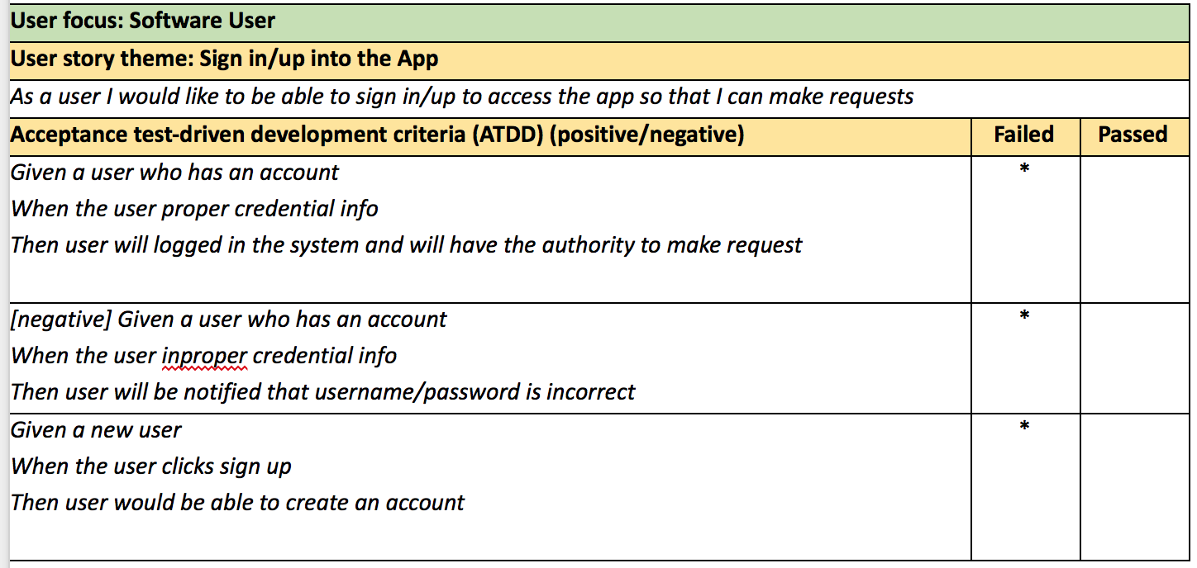

Slide 4
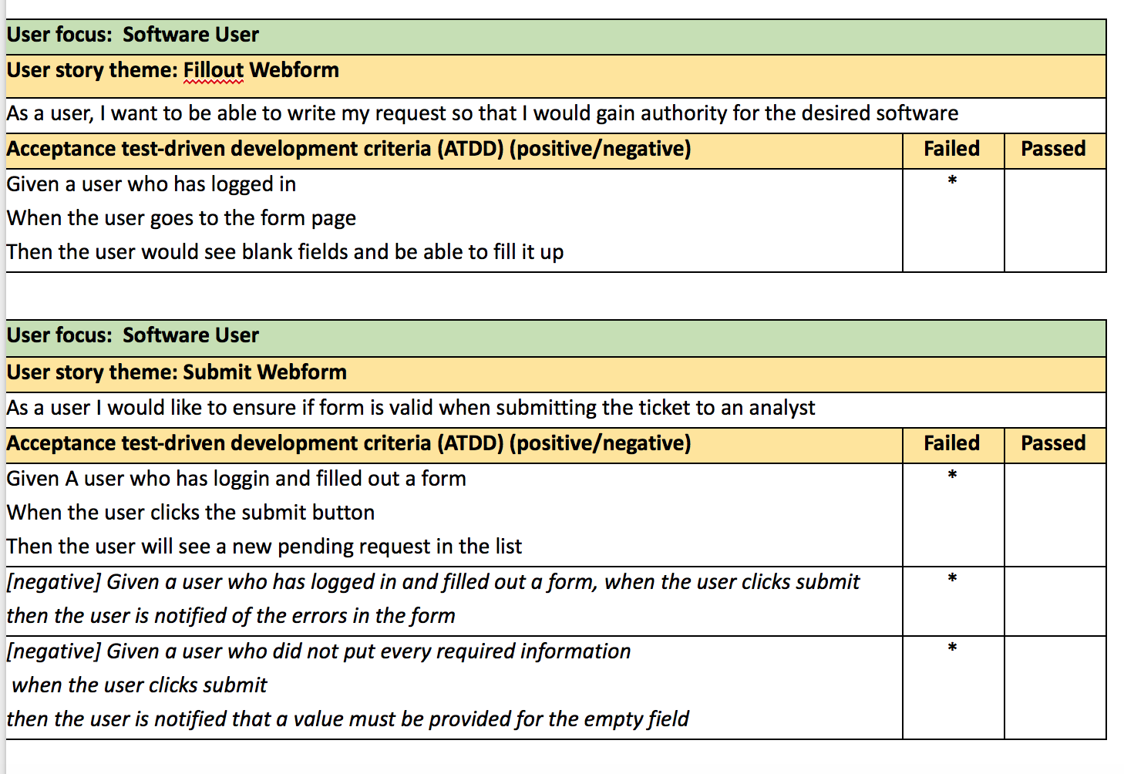

Slide 5
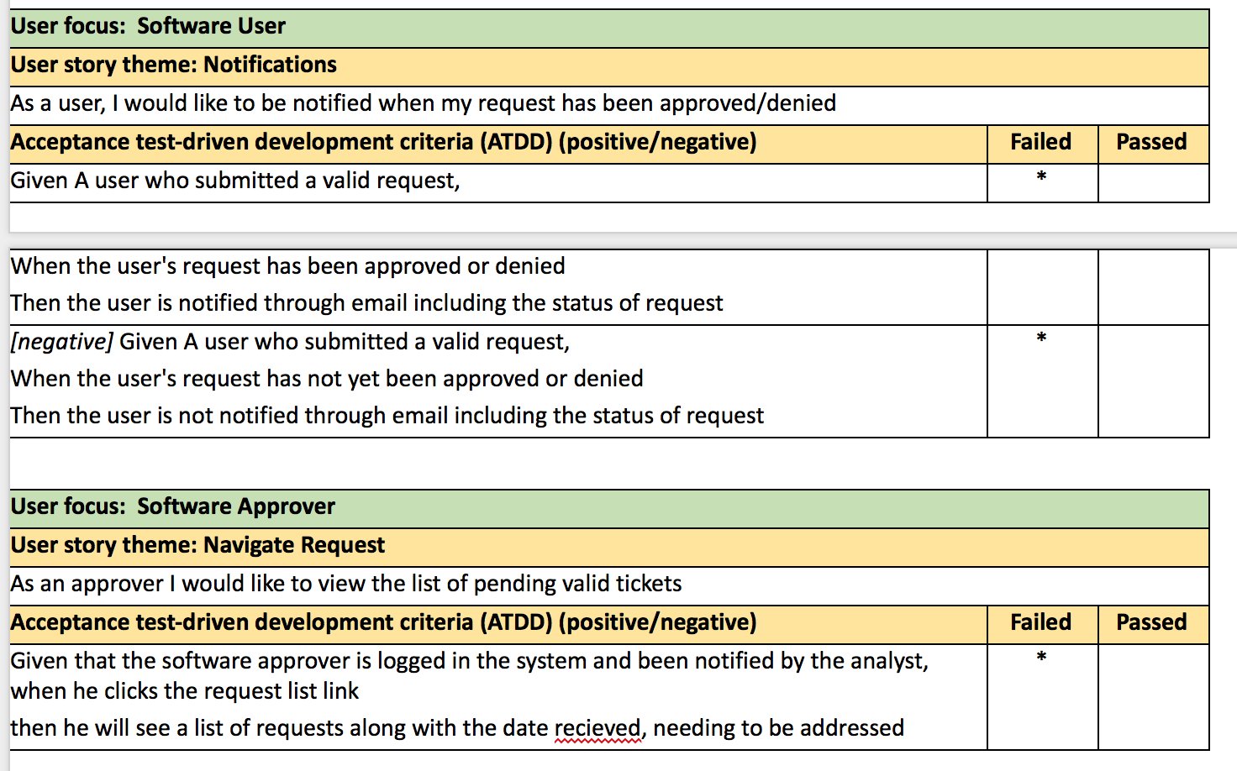

Slide 6
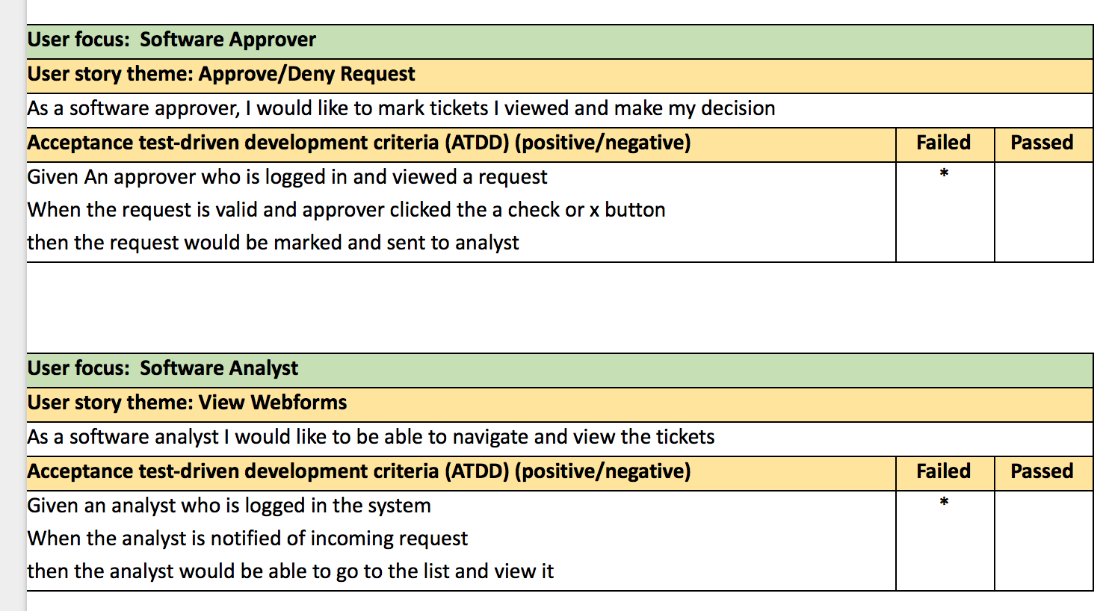

Slide 7
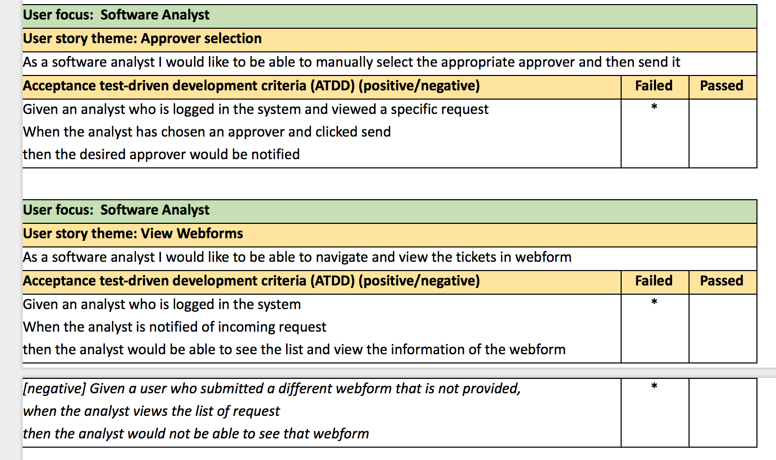
1

Slide 8
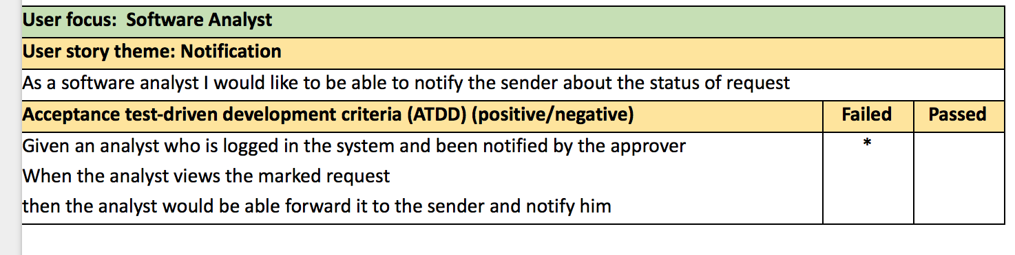

Slide 9
ATDD continued...
Describe your experience
Possible gaps in testing?
Since it is a form of black box test, it will not find the errors of unit/integration testing
Would it have helped to do this pre-lo-fi testing?
Yes, since acceptance test will allow us to expand visual design based on the potential user interactions
Notes:
Earl

Slide 10
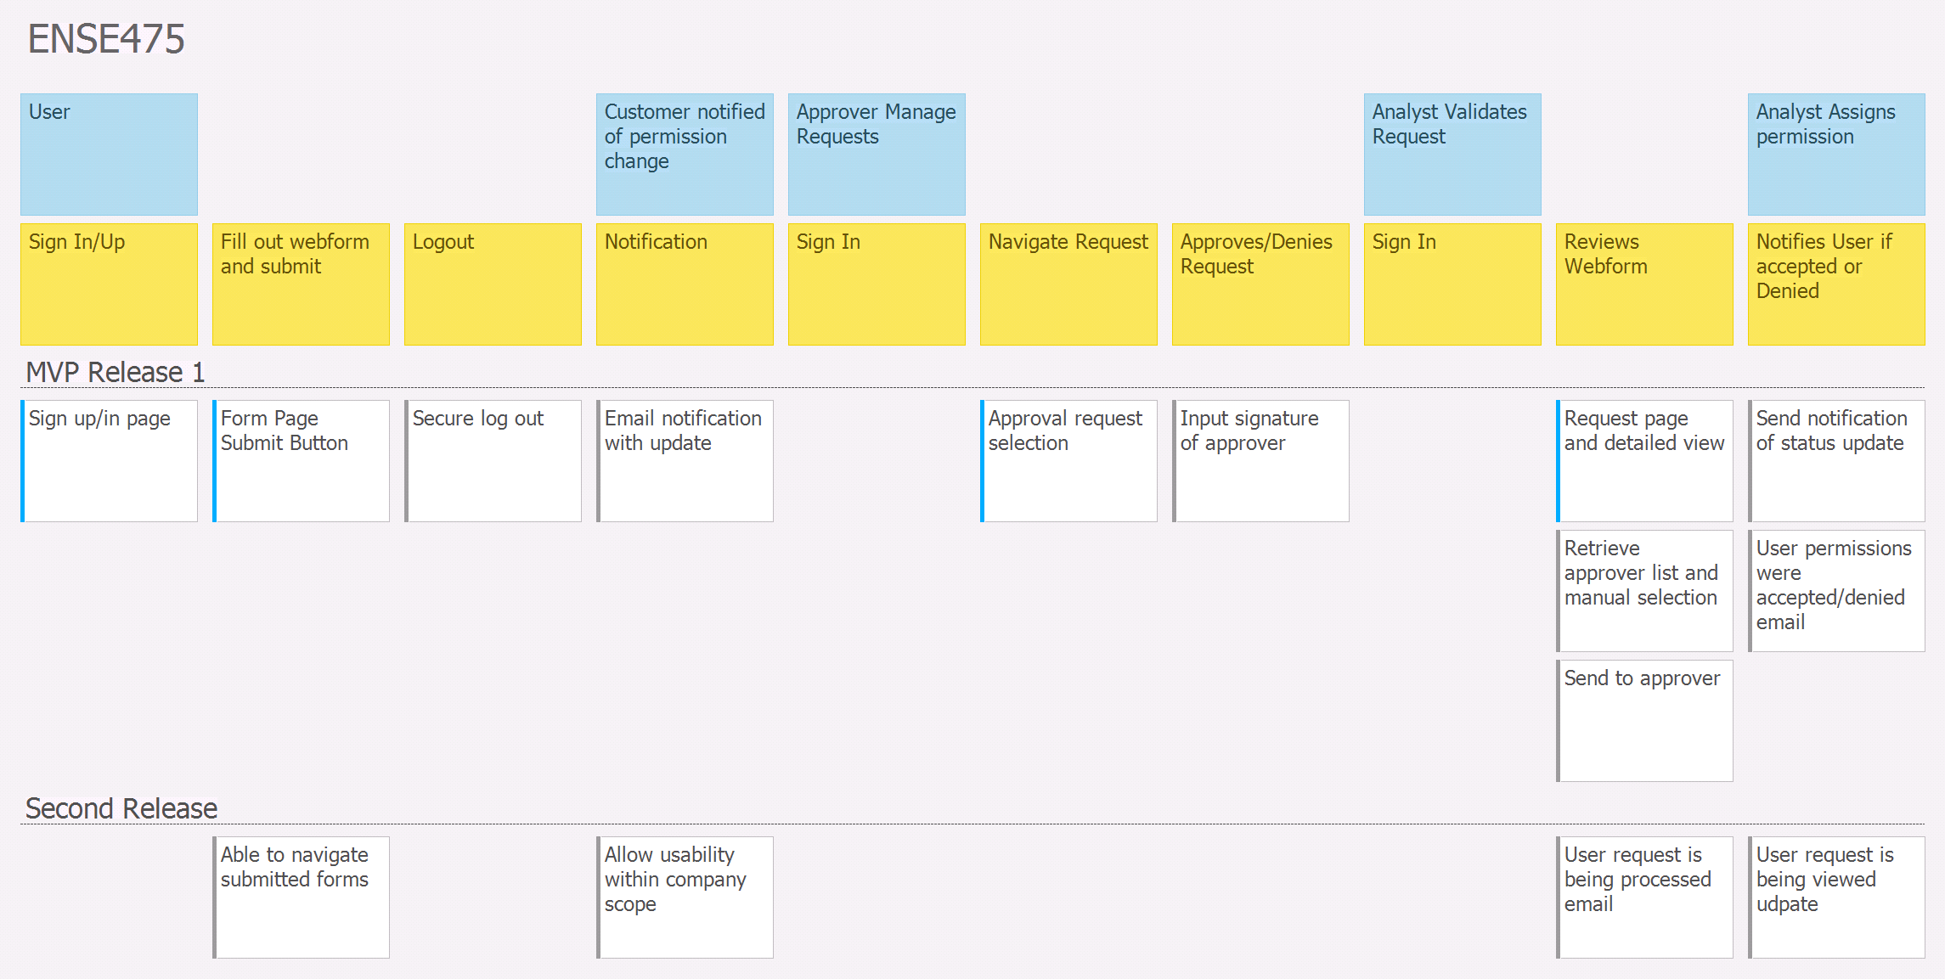

Slide 11
Daily Scrum
User story map for MVP release
Need to define on track: We are on track for milestone 6, but we could have done more for the current milestone.
Backlog update to reflect work. The first tasks have been updated to “doing”.
Notes:
Maks

Slide 12
Daily Scrum continued...
Any barriers to success
Starting the project in a timely manner.
Stories on Board trial expired.
Differing levels of familiarity with chosen Stack. This will be fine in a short amount of time.
Will we be able to achieve more or less of release 1 for our MVP
For the next milestone release 1 product will be achieved. The coding shouldn’t be a problem in the long run.
Achieving more is realistic because most of the functionality is an extension rather than a completely independent new feature
Notes:
Maks

Slide 13
Changes and Misc.
Have your plans changed since your group’s initial conception and project evolution
No changes have been made this milestone since we didn’t get a lot of coding done. Will probably have changes for the next milestone once we dive deep into programming the app.
Notes:
Jenn

Slide 14
Group Reflection
How did you feel about this milestone? What did you like about it? What did you dislike?
We got to code, which is nice.
What did you learn about yourself as you collaborated and worked through this milestone?
Our group likes to do things last minute, which is not fun.
How will you use what you have learned going forward?
Need to plan things out better, we are hoping to start this weekend on milestone 6 to get back on track.
What “stuff and things” related to this milestone would you want help with?
Nothing really.
Notes:
Jenn

Slide 15
Questions?
Notes:
Jenn

